Slide 1

A 2D finite element seismic wave forward modeling code: seisfem
Haipeng Li
16 July 2019

Slide 2
Content
Introduction

Slide 3
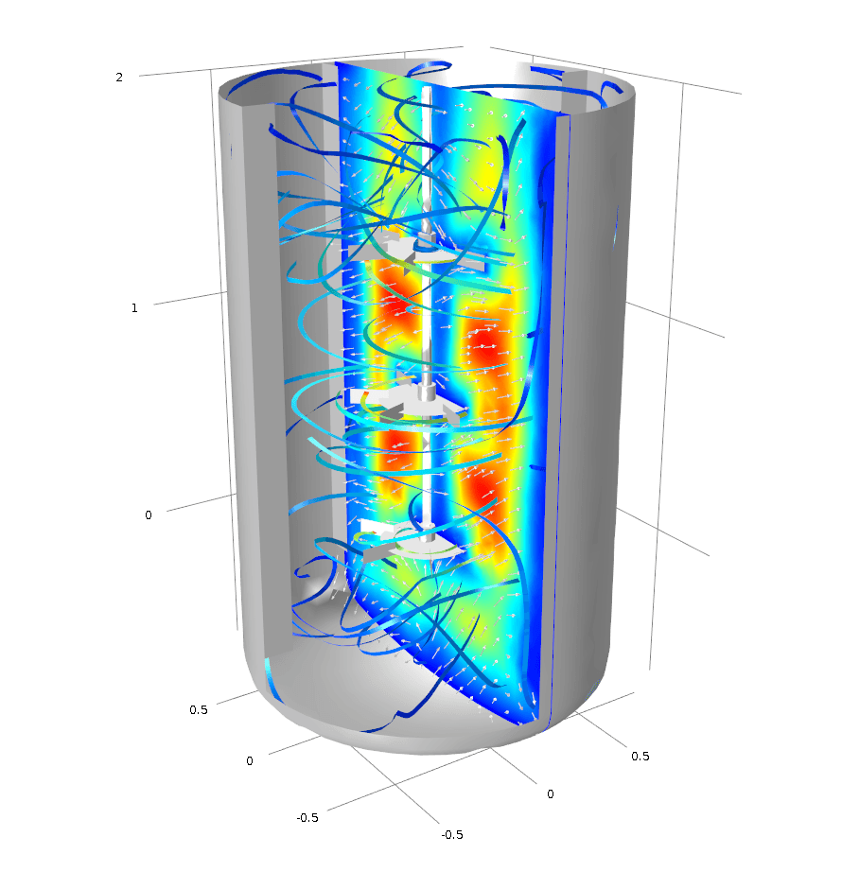
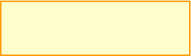

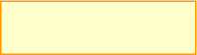
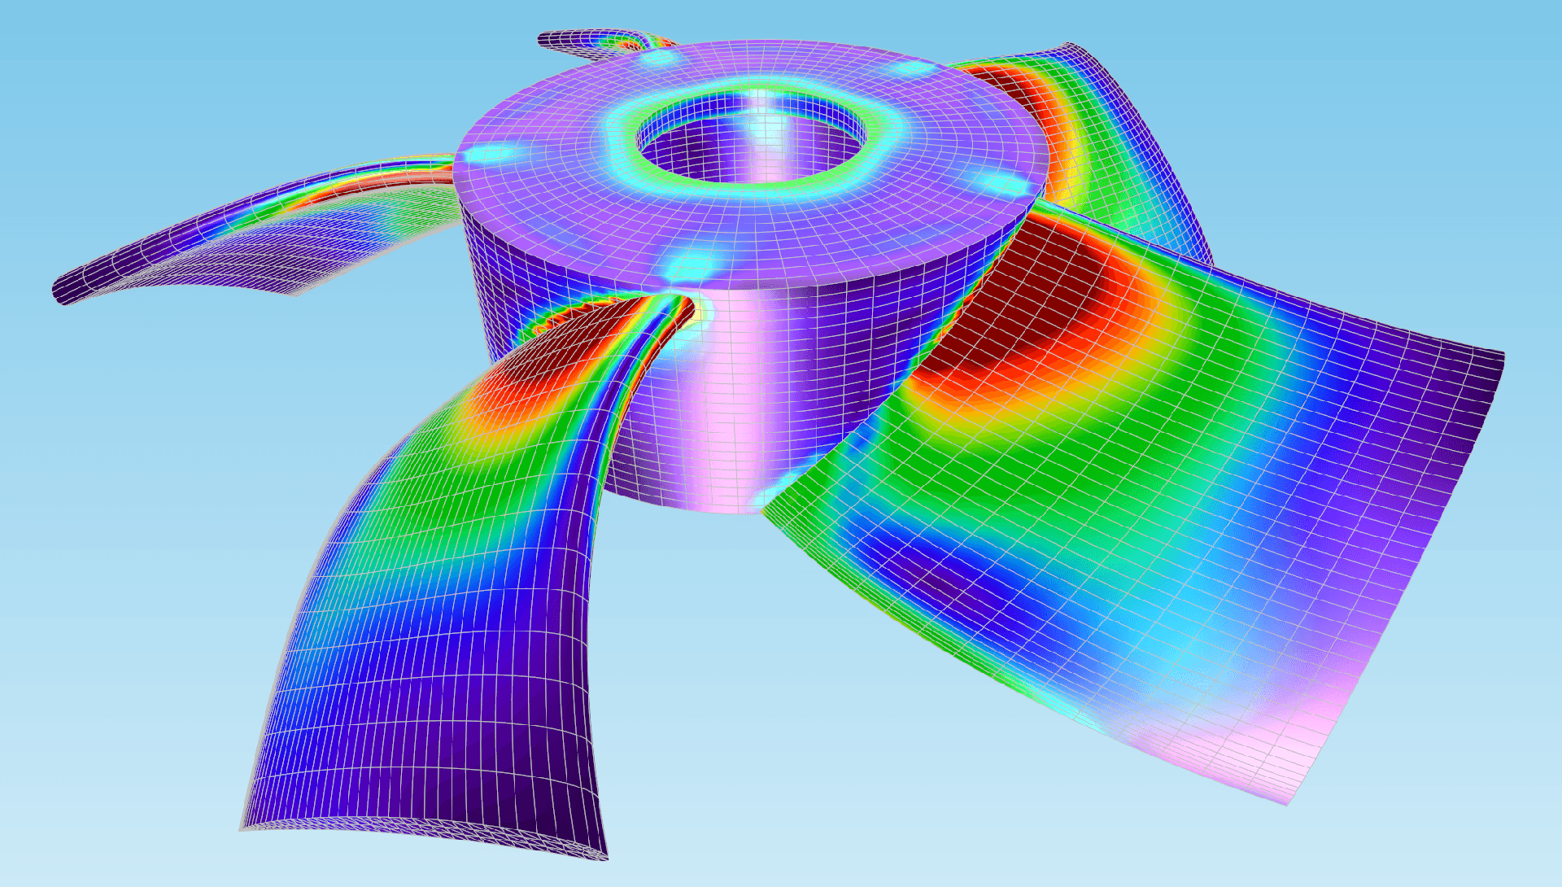
Introduction
Many engineering phenomena can be expressed by
“governing equations” and “boundary conditions”
wave problems
Thermal problems
Fluid flow
Electrostatics
etc.
Governing Equation
(Differential equation)
Boundary Conditions

Slide 4
Introduction
Numerical Method： from continuous to discrete
Discretize the continuous model to discrete model
Discretize the differential equation
Finite Difference Method (FDM) Strong form
Finite Element Method (FEM) Weak form
Finite Volume Method (FVM) Semi-weak form
Spectral Element Method (SEM) Weak form
etc.
Solve the discrete system

Slide 5
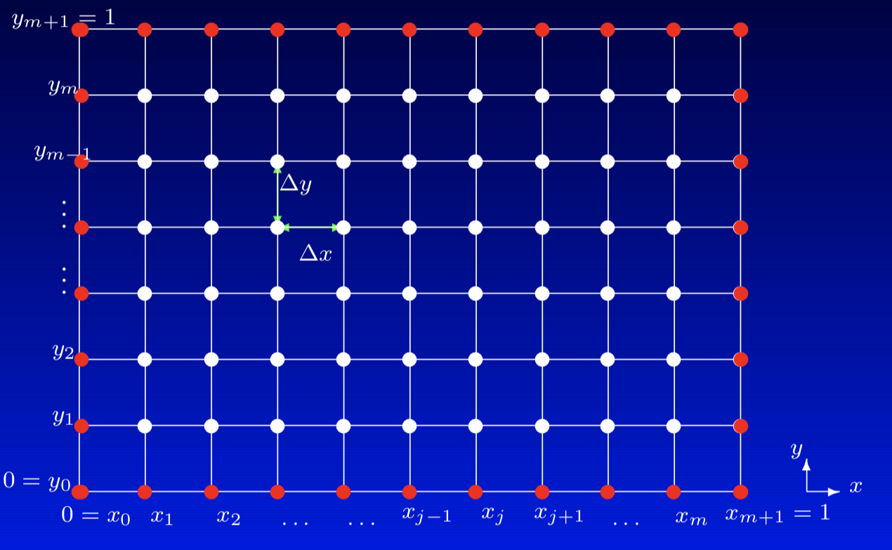
Introduction
Finite Difference Method: Based upon the local Taylor expansion
Forward Difference
Backward Difference
Centered Difference

Slide 6
Introduction
Finite Element Method : Based upon Weighted Residuals and Variational Principles
: basic function
: test function
Weak form of differential equation

Slide 7
Introduction
Differences and Similarities
Basic function
Finite Element Method
is local shape function
Spectral Element Method
is N^{th}-degree Lagrange polynomials and quadrature points are EXATLY Gauss-Lobatto-Legendre points
Test function
Continuous Galerkin Finite Element Method
Finite Volume Method
Finite Difference Method
Different numerical methods are usually more similar
than they are distinct.

Slide 8
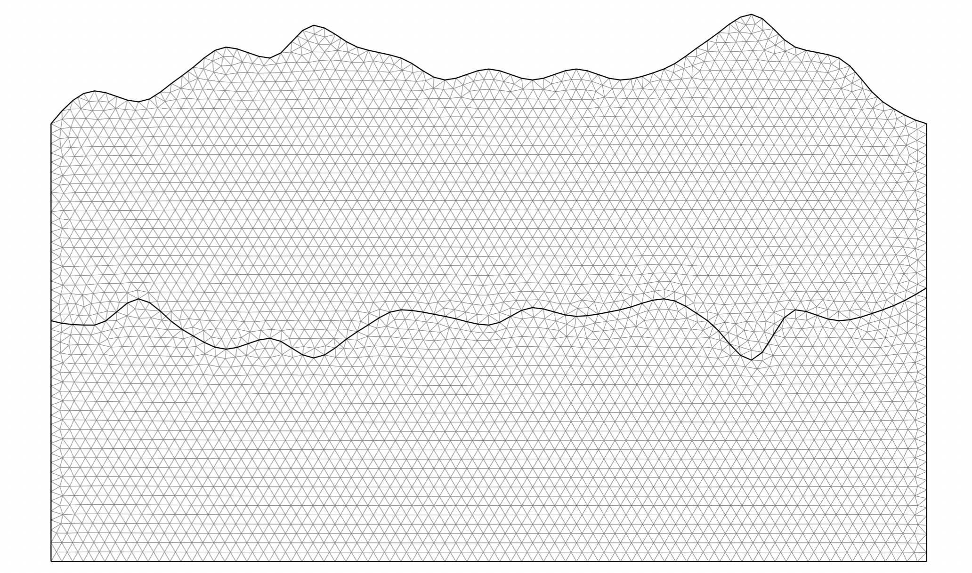
Introduction
Why FEM
Can readily handle very complex geometry:
The heart and power of the FEM
Can easily handle boundary conditions
Dirichlet boundary
Neumann boundary
Mixed boundary
naturally satisfies free surface boundary
Can handle complex loading
Nodal load
Element load
Time or frequency dependent loading
Can handle a wide variety of engineering problems
Wave problems, Heat problems, Solid mechanics, Fluids problems, etc.

Slide 9
Introduction

Slide 10
Content
Introduction

Slide 11
Second-order elastic wave equation
s.t.
General algebraic form
mass matrix damping matrix stiffness matrix right hand load vector

Slide 12
Perfectly Matched Layers

Slide 13
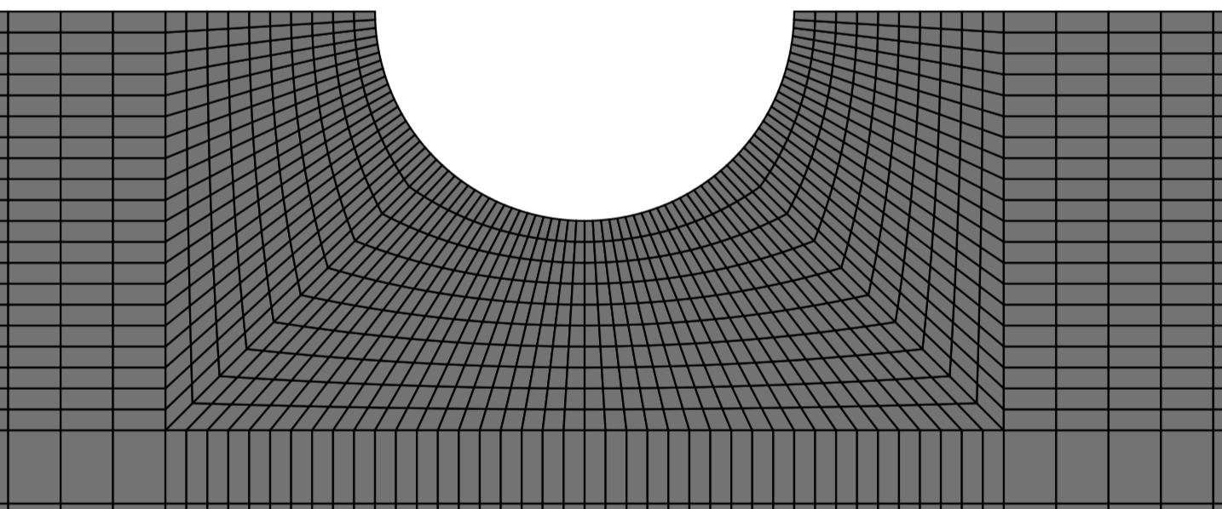
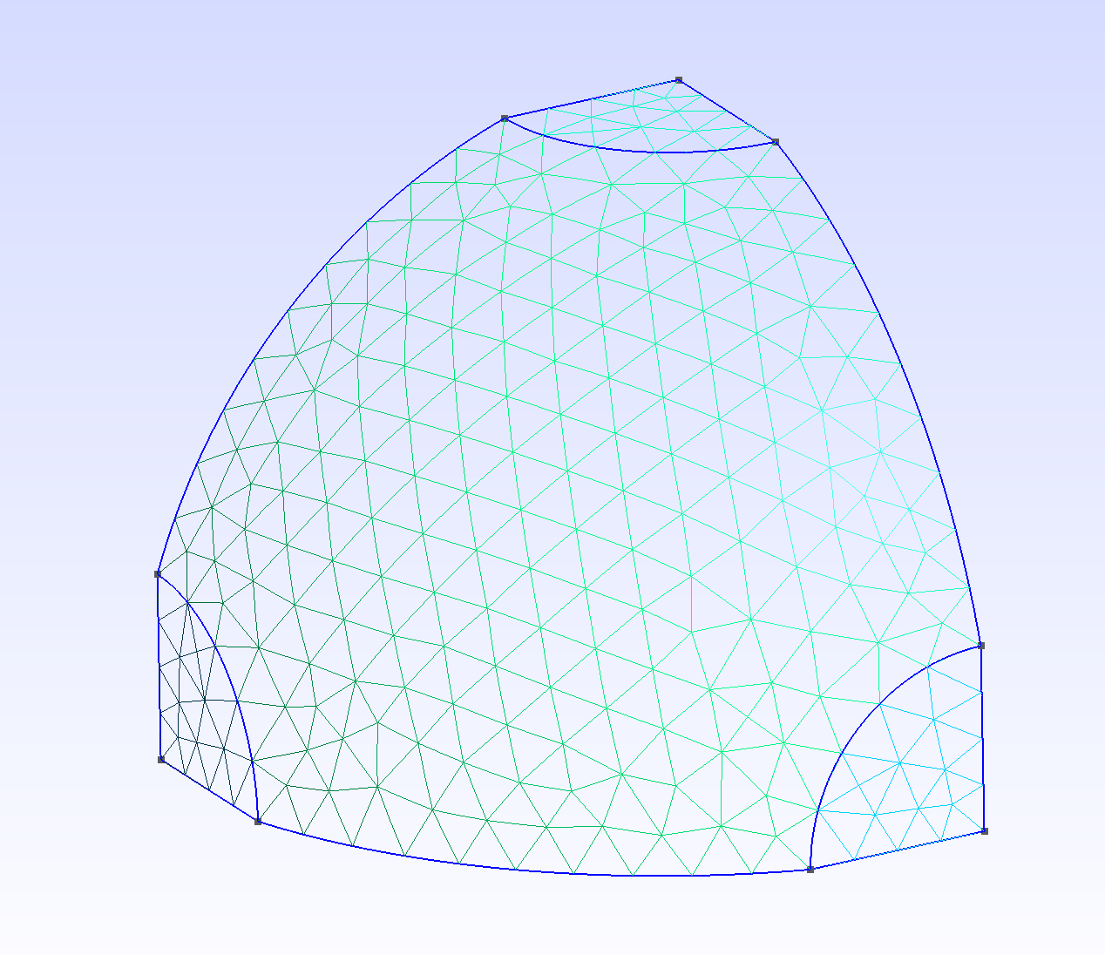
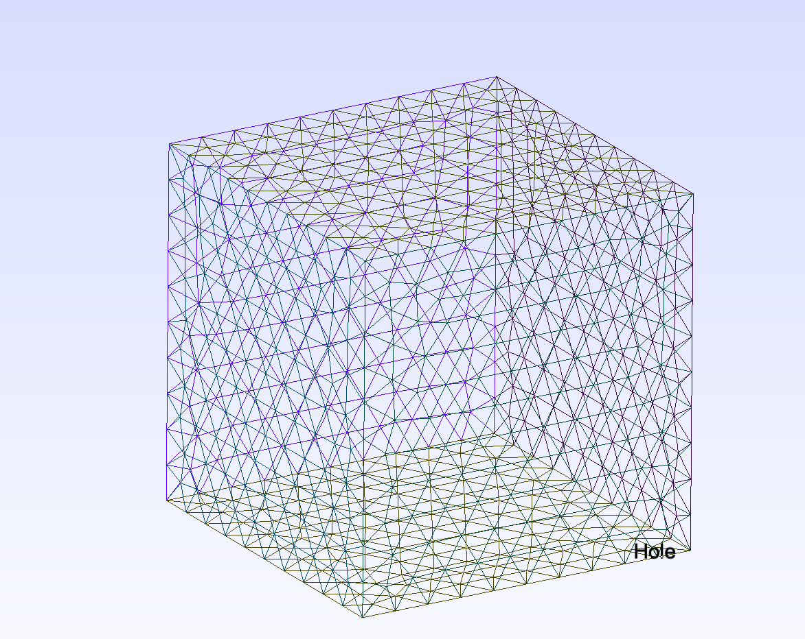

Slide 14
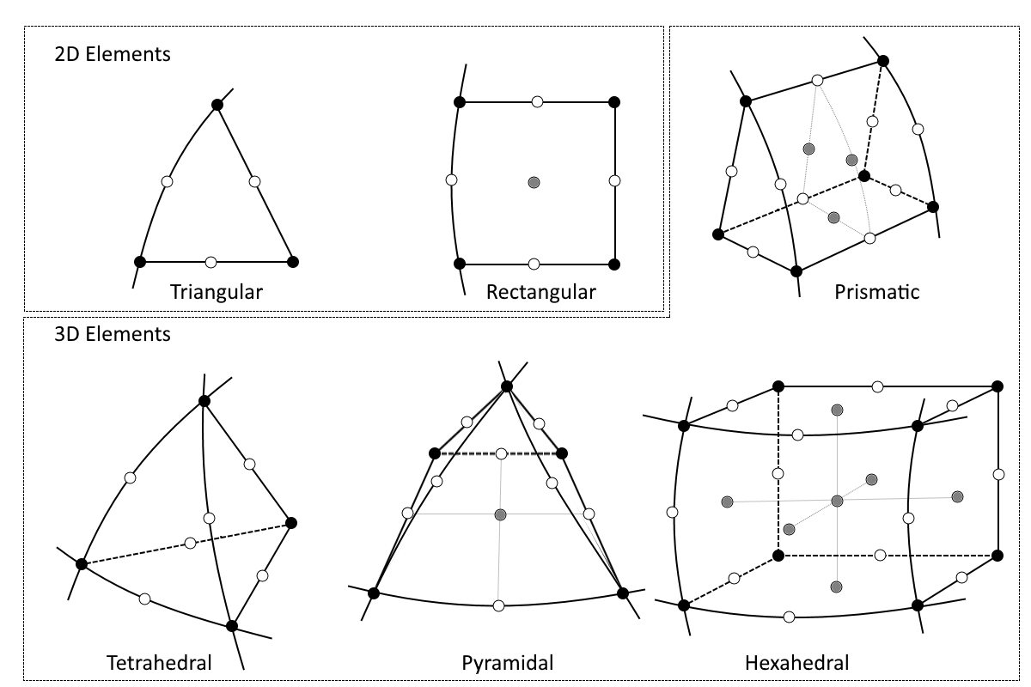
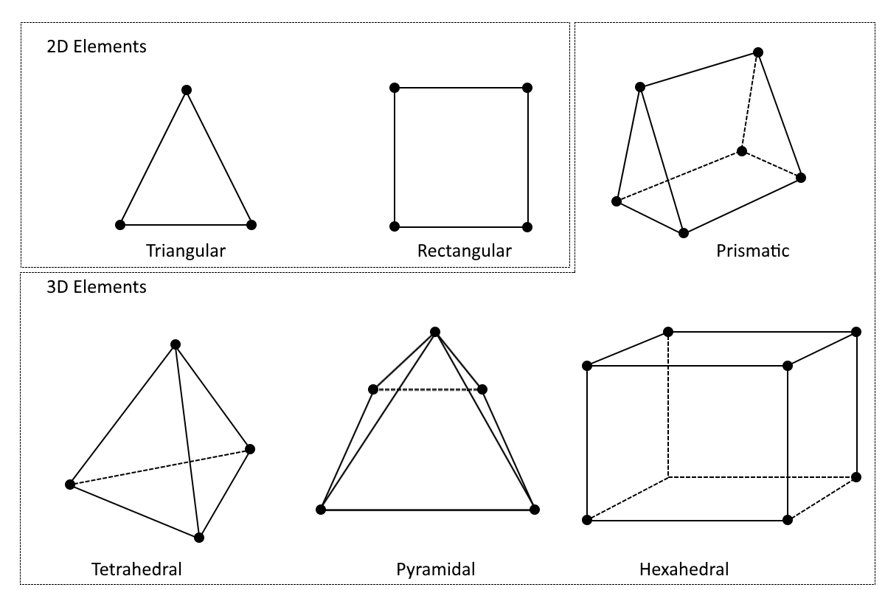
Mapping to Canonical Element
Mapping

Slide 15
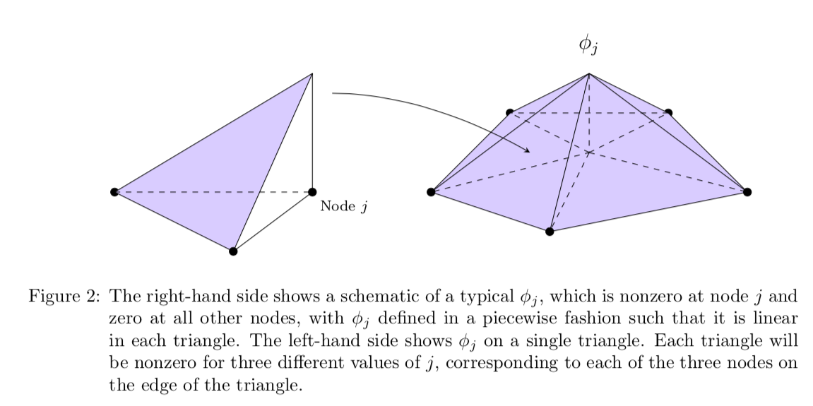
Define Basis Function

Slide 16
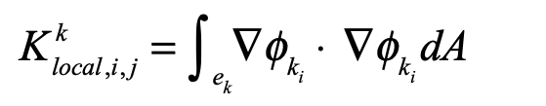
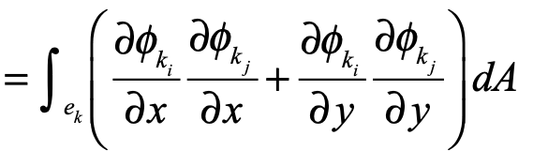
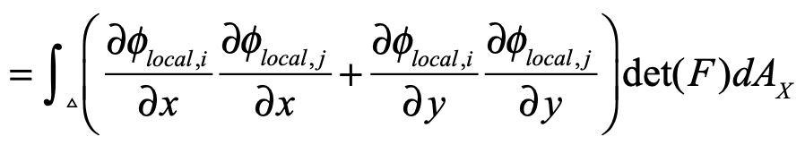
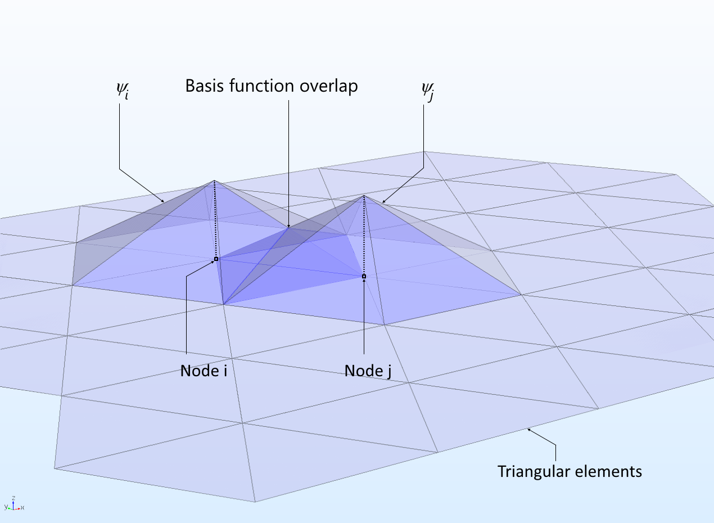
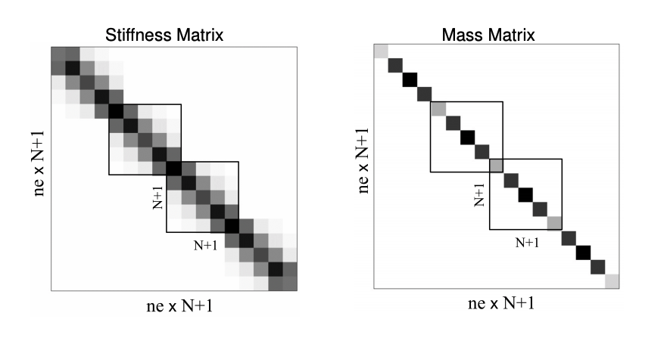
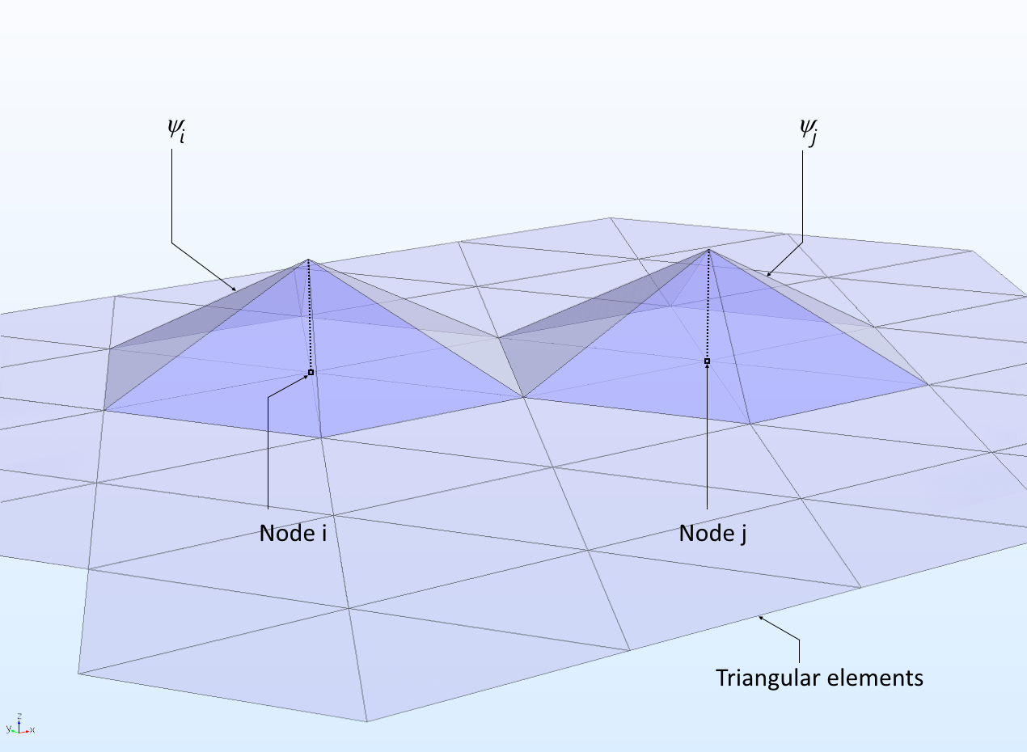
Element by element

Slide 17
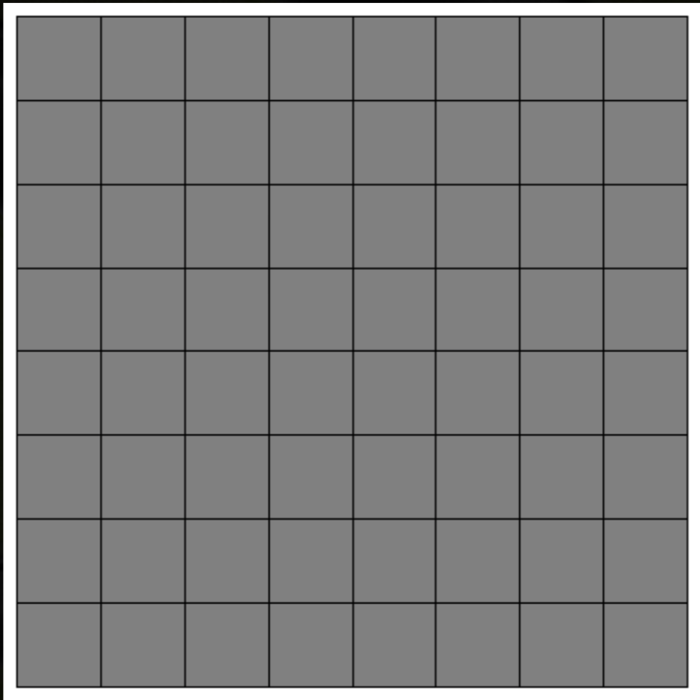
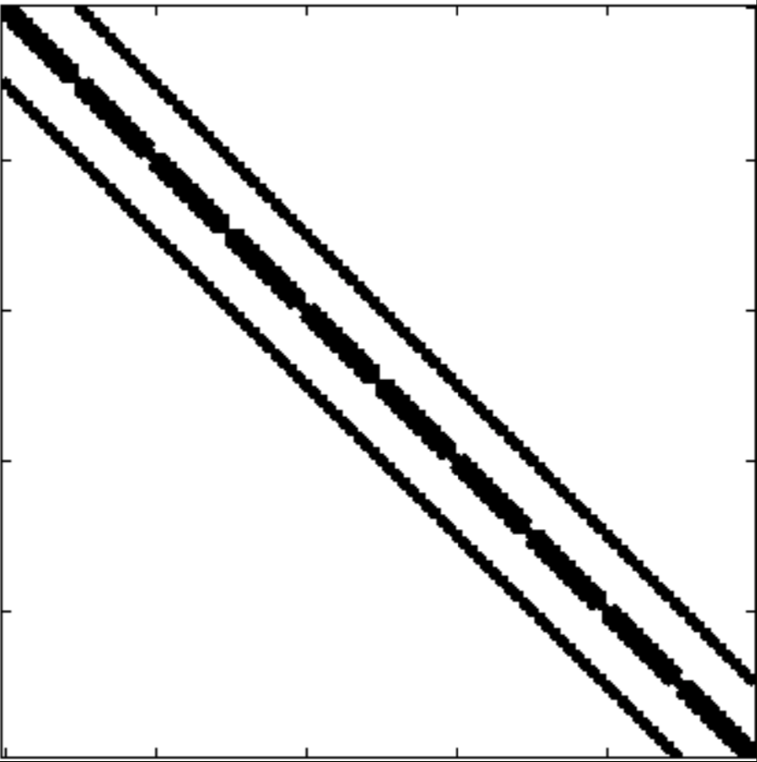
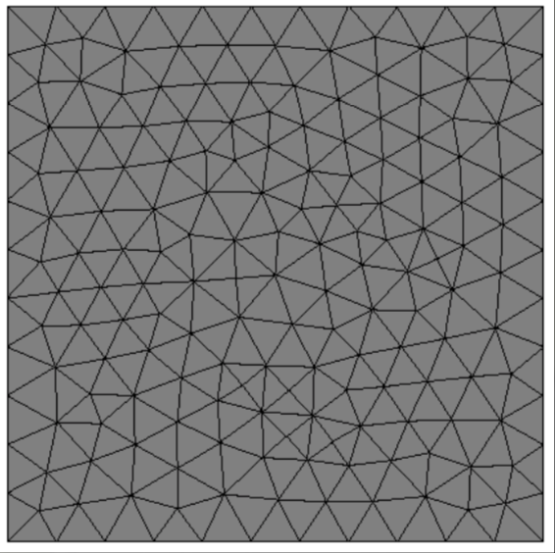
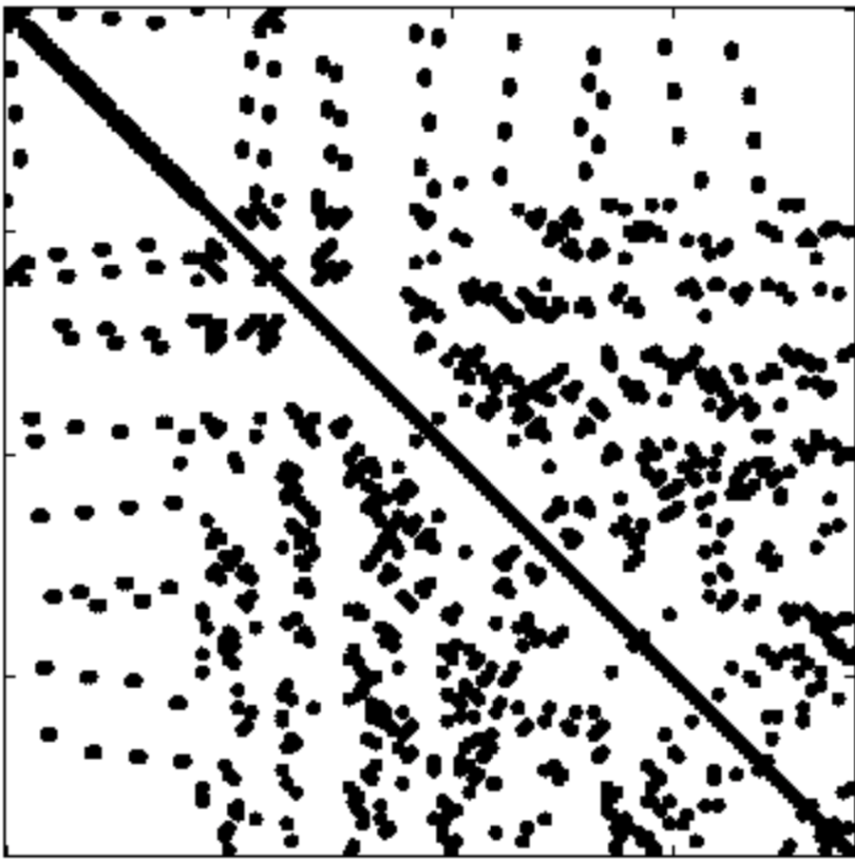

Slide 18
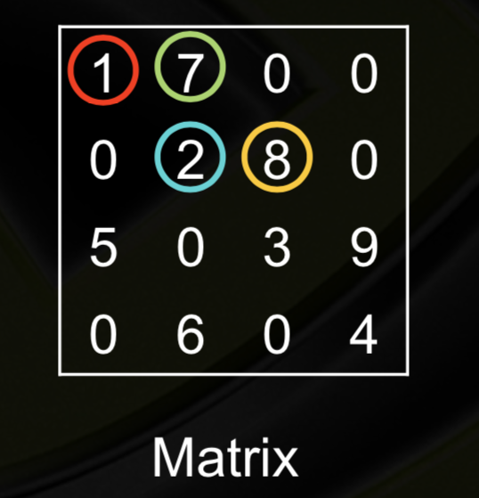
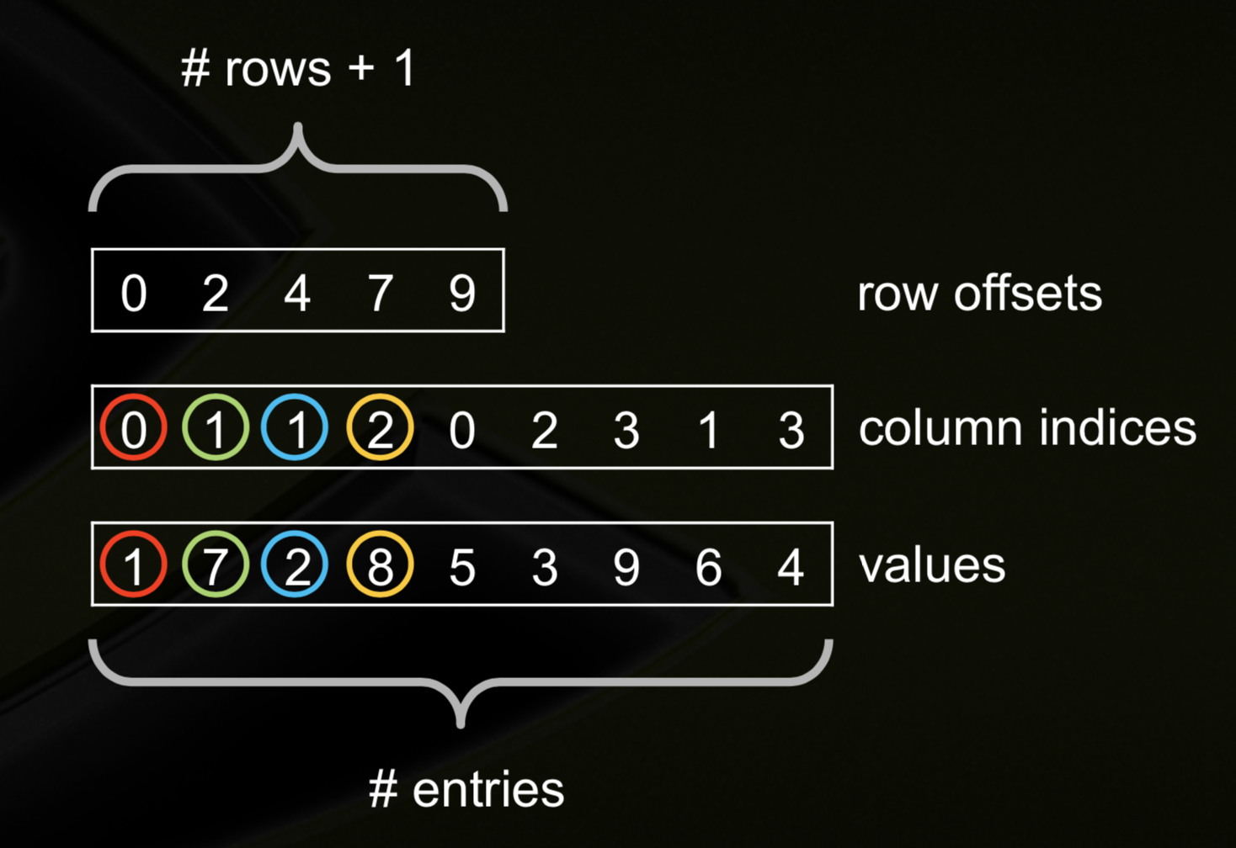
Full Matrix
Coordinate (COO)
Compressed Sparse Row (CSR)
A 200*200 model Storage Format Comparison
Methods | Full Matrix | COO Format | CSR Format
Memory (MB) | 12207.03 | 3.05 | 2.44

Slide 19
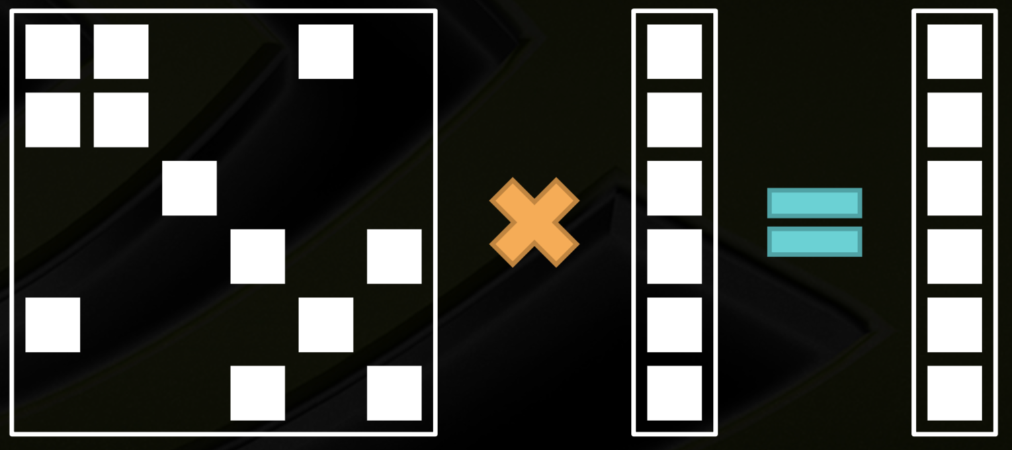
1. Abstract and Introduction

Slide 21
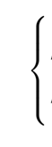
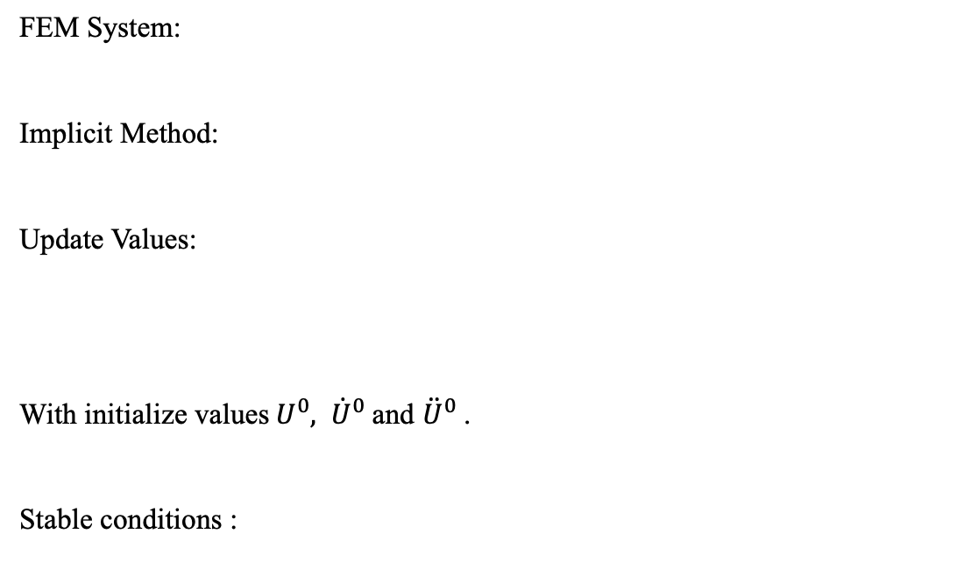
The Newmark method
FEM System:
Implicit Method:
Update Values:
With initialize values${ U}^{0}, {\dot{U}}^{0}$ and ${\ddot{U}}^{0}$.
Stable conditions :

Slide 22
求解微分方程的另一大方法是有限元法，而谱方法与有限元法的差别仅在于，
这些基函数在求解域中所使用的范围。谱方法将方程的解用基函数在全求解域展开，
而有限元法只用于某个单元内的区域展开。因此，谱方法的这种全局特性就决定了
它优缺点：解是误差特性非常好，即所谓的“指数收敛”；同样的模型和网格下，
相对有限差分说，计算量低且精度高；然而，对于复杂几何形态的模型和不连续界面，
它会出现Gibbs现象而严重影响它的求解精度。
谱方法的基函数全都是正交的，而且是全局的，谱元法就是把区域分割成网格，
在每个小网格上选取正交基函数，就相当于把网格剖分与谱方法结合起来。
Spectral Element Method. 将谱方法和有限元结合起来。本质上是Galerkin方法的应用。
应用过程中，首先使用有限元的方法进行离散化。然而在单元内部使用谱方法进行差值。
Orthogonality between basis functions in the h- and p-versions of the FEM is uniquely due to
nonoverlapping local functions. This is where SEM s depart from the two other families;
orthogonality is related to both the topological nature (local extension) and the
analytical nature of the basis functions.
我接触到的SEMs在插值的时候应用的是Gauss-Lobatto-Legendre点。
因为多项式的正交性，所以在Gauss quadrature的过程中，多项式本身并不出现，
在简单的变成中多数出现三个矩阵，质量矩阵A即gauss quadrature的权重构成的矩阵。
convective矩阵C，即N-S方程中的convective 项。 以及矩阵B,由Galerkin Method 在降次二阶
偏导数的时候产生。而在FEM的求解过程中，系数矩阵的产生与SEMs不同。

Slide 23
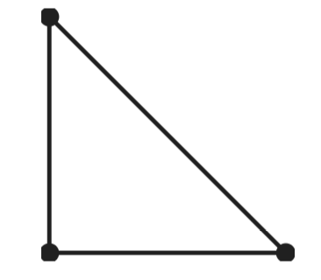
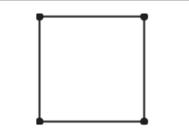
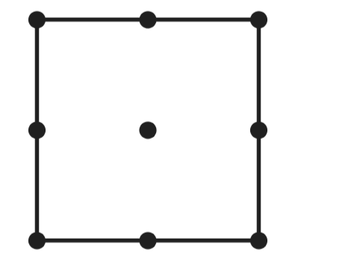



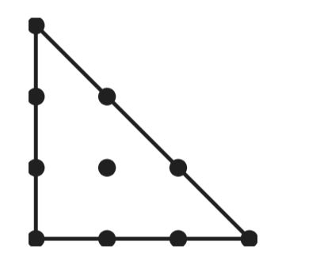
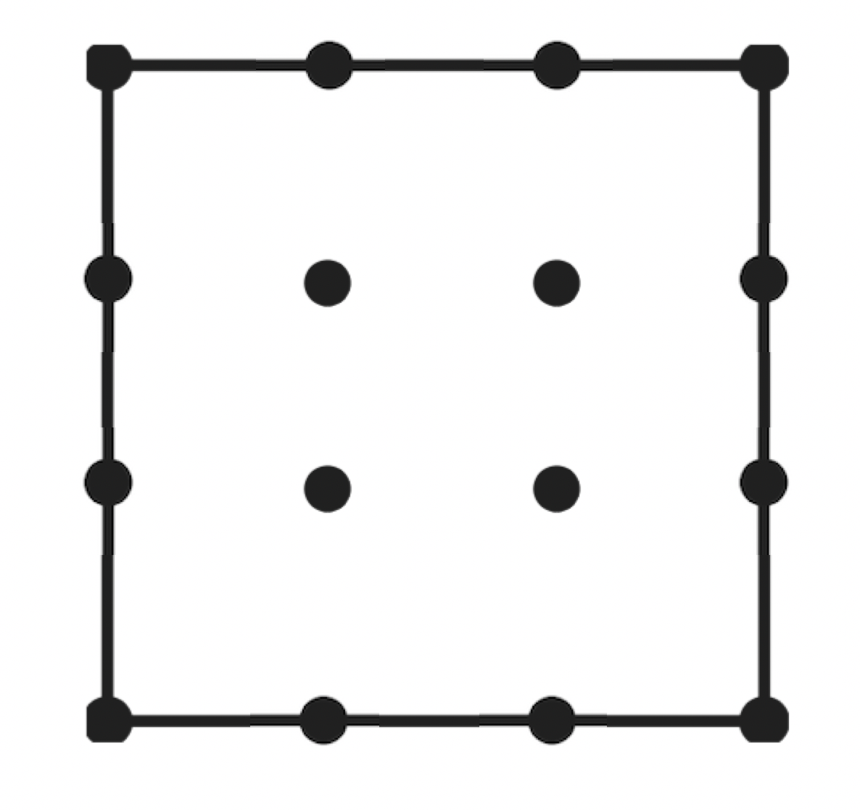
1. Abstract and Introduction
Initialization
superlu library, blas library, openmp library
pardiso library (academic license)
Reading of parameters files
Mesh the model
element_type, element_num, element_node
node_num, node_xy
read meshfile, if use unstructured mesh
Element Type | Triangle element | Quadrilateral element
Linear: First-order | T3 | Q4
Quadratic: Second-order | T6 | Q9
Cubic: Third-order | T10 | Q16

Slide 24
Set elastic parameters
setup of rho, vp, vs, c11, c13, c33 and c44
setup of receivers
setup of sources
setup of time step dt
setup of PML
Calculation of local stiffness and mass matrix
calculation of integration points and integration weights
calculation of Jacobians and Jacobi-Matrices
calculation of shape functions
Assembly of global stiffness and mass matrix
calculation global matrix in coo sparse matrix format
sum duplicates in coo format
resort coo format
convert coo to csr sparse matrix format
–
–

Slide 25
Time-Loop: Integration in the time domain (explicit scheme)
reading of initial displacement field data
calculation source signal (Ricker-wavelet)
implementation of boundary conditions
solve linear system and update displacement
Writing seismograms to output files
Solver Type | Description
pardiso | LU decomposition, fast and accurate, packages license required
mgmres | Generalized Minimum Residual algorithm, slow but very accurate
masslump | Mass lumped technique, very fast but long time simulation unstable

